Slide 1

DATA STRUCTURE WEEK Eight & Nine
Contact Details:
Email: sobia.iftikhar@nu.edu.pk
GCR:

Slide 2
Efficient/Advance sorting techniques
Stacks
Queue

Slide 3
Class One

Slide 4
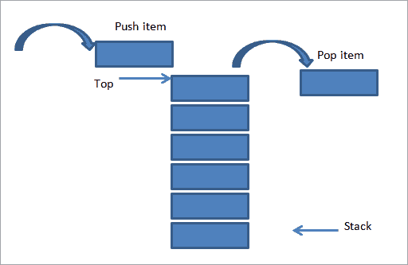
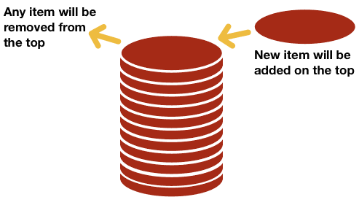
STACKS
What is a Stack?
A stack is a data structure of ordered items such that items can be inserted and removed only at one end.
In our day to day life, we see stacks of plates, coins, etc. All these stacks have one thing in common that a new item is added at the top of the stack and any item is also removed from the top i.e., the most recently added item is removed first.

Slide 5
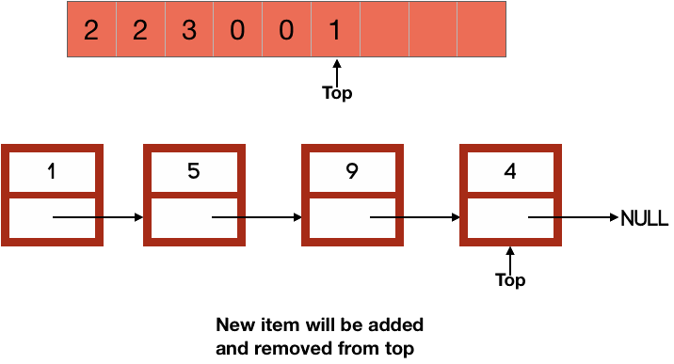
STACKS
In our day to day life, we see stacks of plates, coins, etc. All these stacks have one thing in common that a new item is added at the top of the stack and any item is also removed from the top i.e., the most recently added item is removed first.

Slide 6
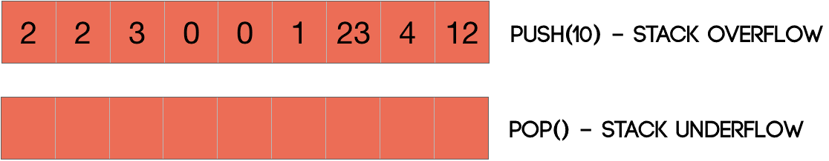
STACK UNDERFLOW & STACK OVERFLOW
We also handle two errors with a stack. They are stack underflow and stack overflow. When we try to pop an element from an empty stack, it is said that the stack underflowed. However, if the number of elements exceeds the stated size of a stack, the stack is said to be overflowed.

Slide 7
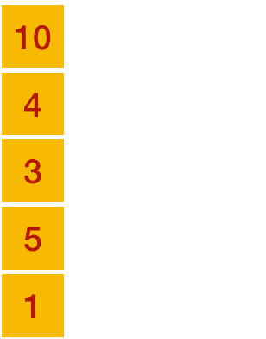

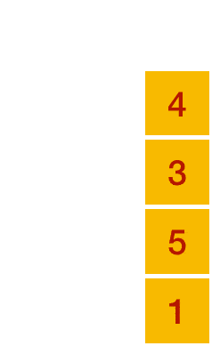
Basic-Operation STACKS
Stack operations may involve initializing the stack, using it and then de-initializing it. Apart from these basic stuffs, a stack is used for the following two primary operations −
push() − Pushing (storing) an element on the stack.
pop() − Removing (accessing) an element from the stack.
When data is Pushed onto stack.
To use a stack efficiently, we need to check the status of stack as well. For the same purpose, the following functionality is added to stacks −
peek() − get the top data element of the stack, without removing it.
isFull() − check if stack is full.
isEmpty() − check if stack is empty

Slide 8
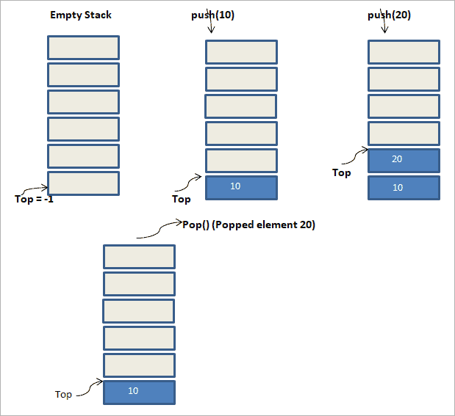

Slide 9
IMPLEMENTATION
void push(int data) {
if(!isFull()) {
top = top + 1;
stack[top] = data;
} else {
printf("Could not insert data, Stack is full.\n");
}
}
Step 1 − Checks if the stack is full.
Step 2 − If the stack is full, produces an error and exit.
Step 3 − If the stack is not full, increments top to point next empty space.
Step 4 − Adds data element to the stack location, where top is pointing.
Step 5 − Returns success.
Push Operation
Step 1 − Checks if the stack is empty.
Step 2 − If the stack is empty, produces an error and exit.
Step 3 − If the stack is not empty, accesses the data element at which top .
Step 4 − Decreases the value of top by 1.
Step 5 − Returns success.
int pop(int data) {
if(!isempty()) {
data = stack[top];
top = top - 1;
return data;
} else {
printf("Stack is empty.\n");}}
Pop Operation
bool isempty() {
if(top == -1)
return true;
else
return false;
}
bool isfull() {
if(top == MAXSIZE)
return true;
else
return false;
}

Slide 10
IMPLEMENTING A STACK
There are two ways we can implement a stack:
Using an array
Using a linked list

Slide 11
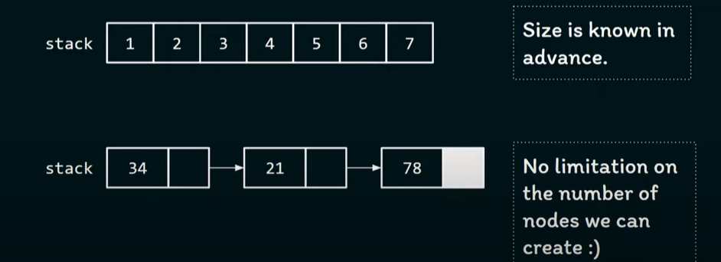
HOW WE IDENTIFY WHICH WAY IS BETTER TO CREATE STACK, ARRAY OR LL?
Answer is: when we don’t know the size of stack we should use LL. Otherwise go with Array

Slide 12
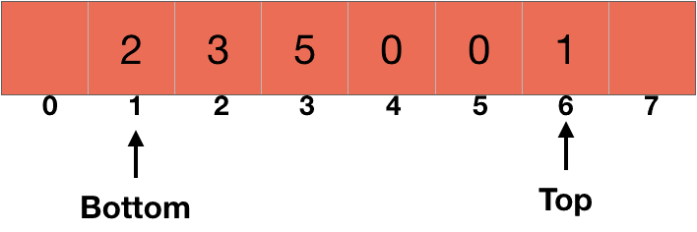
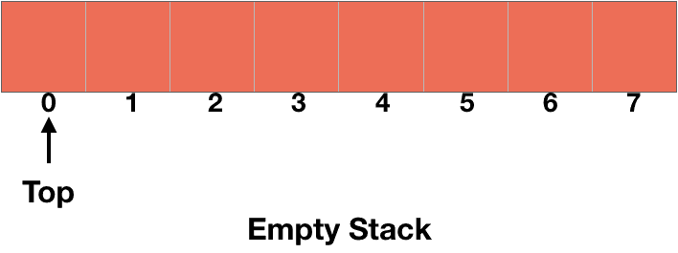
STACK USING ARRAY
We are going to use the element at the index 1 of the array as the bottom of the stack and the last element of the stack as the top of the stack as described in the picture given below.
Since we need to add and remove elements from the top of the stack, we are going to use a pointer which is always going to point the topmost element of the stack. It will point to the element at index 0 when the stack is empty.

Slide 13
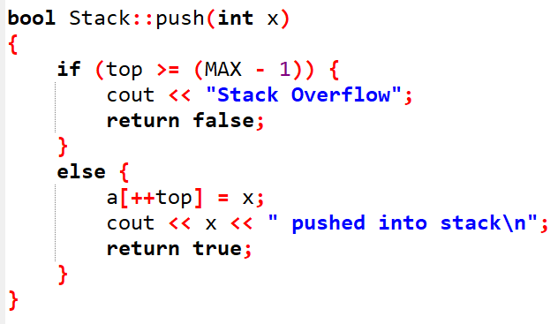
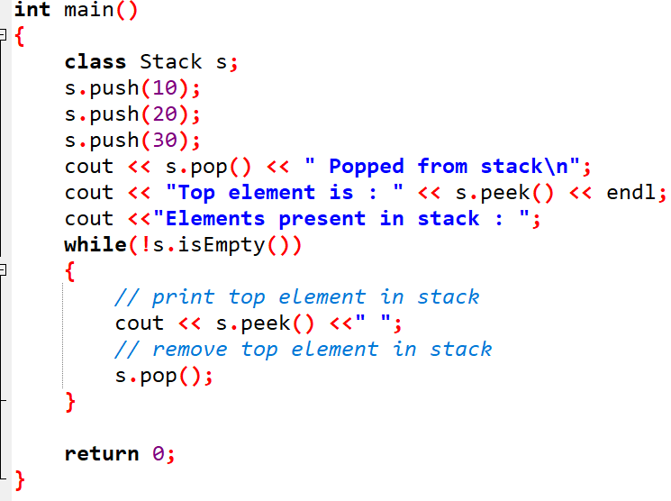
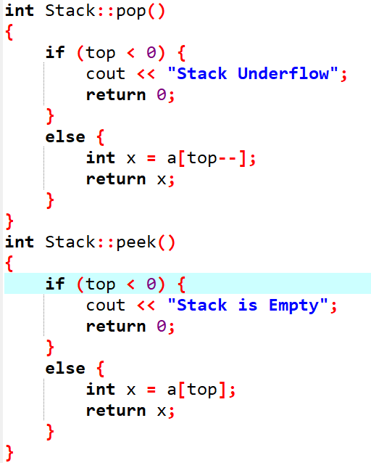
IMPLEMENTATION

Slide 14
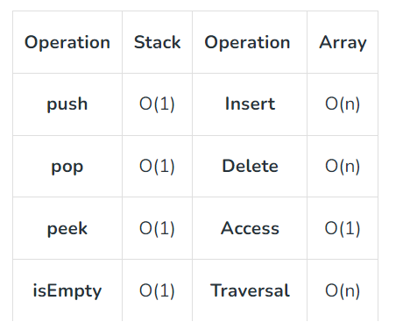
Summary

Slide 15
IMPLEMENTATION WITH LL
We will select the beginning of ll as the top of stack.
A stack is represented using nodes of a linked list. Each node consists of two parts: data and next(storing address of next node).
The data part of each node contains the assigned value and the next points to the node containing the next item in the stack.
The top refers to the topmost node in the stack.
Both the push() and pop() operations are carried out at the front/top of the linked list and hence takes O(1) time.

Slide 16
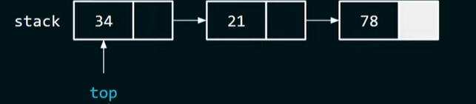
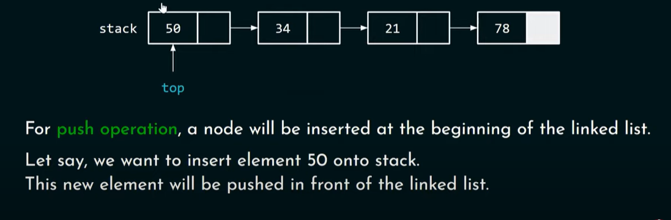
We will select the beginning of ll as the top of stack.

Slide 17
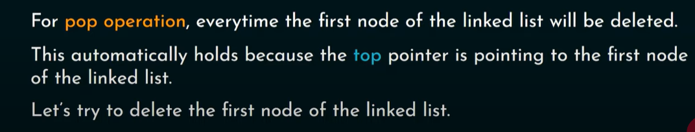
POP OPERATION
But Why we prefer Adding and removing the first node of the linked list?

Slide 18
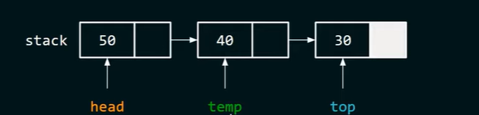
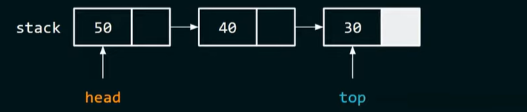
BUT WHY WE PREFER ADDING AND REMOVING THE FIRST NODE OF THE LINKED LIST?
Time Complexity of PUSH() operation is O(1)
Time Complexity of POP() operation is O(1)
These two are the constant and same.
But what if we consider top is last node of the linked list?
Time Complexity of PUSH() operation is O(1)
Time Complexity of POP() operation is O(n)// traversing required

Slide 19
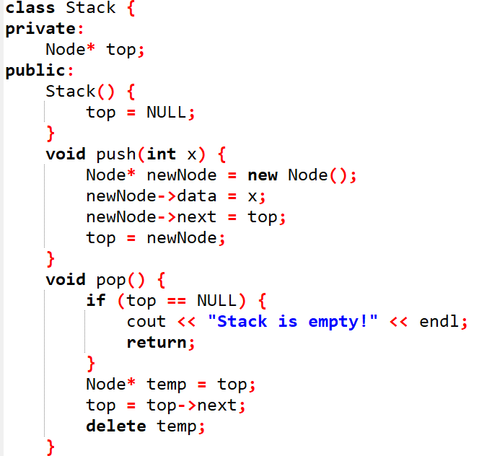
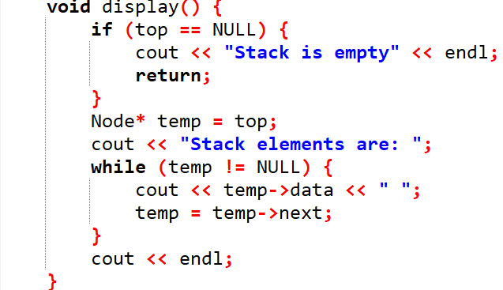
EXAMPLE

Slide 20
1. Evaluation of Arithmetic Expressions
Notations for Arithmetic Expression
There are three notations to represent an arithmetic expression:
Infix Notation
Prefix Notation
Postfix Notation

Slide 21
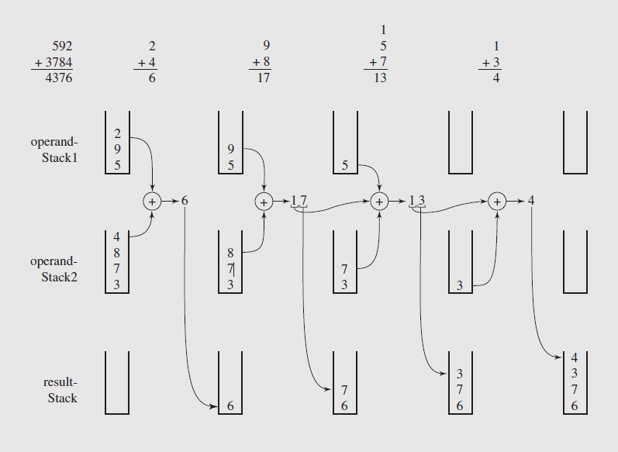
ADDING LARGE NUMBERS

Slide 22
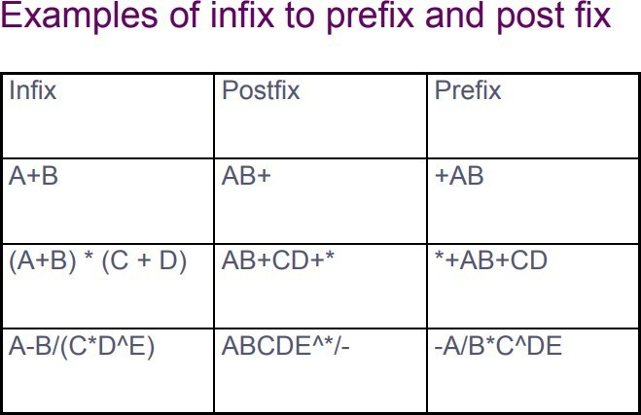
INFIX TO POSTFIX CONVERSION

Slide 23
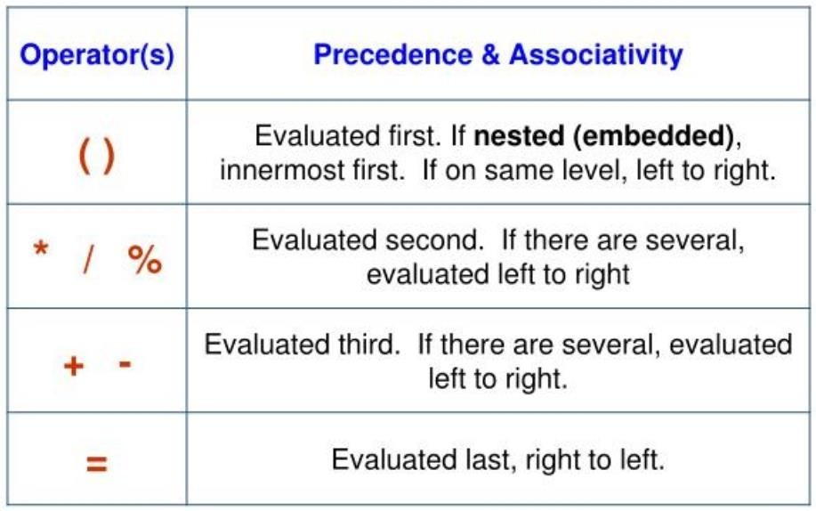
RULES OF OPERATOR PRECEDENCE

Slide 24
INFIX TO POSTFIX CONVERSION
Rules to follow:
•
Print operands as they arrive.
If the stack is empty or contains a left parenthesis on top, push the incoming operator onto the stack.
If the incoming symbol is a left parenthesis, push it on the stack.
If the incoming symbol is a right parenthesis, pop the stack and print the operators until you see a left parenthesis. Discard the pair of parentheses.
If the incoming symbol has higher precedence than the top of the stack, push it on the stack.
If the incoming symbol has equal precedence with the top of the stack, use association. If the association is left to right, pop and print the top of the stack and then push the incoming operator. If the association is right to left, push the incoming operator.
If the incoming symbol has lower precedence than the symbol on the top of the stack, pop the stack and print the top operator. Then test the incoming operator against the new top of stack.
At the end of the expression, pop and print all operators on the stack. (No parentheses should remain.)

Slide 25
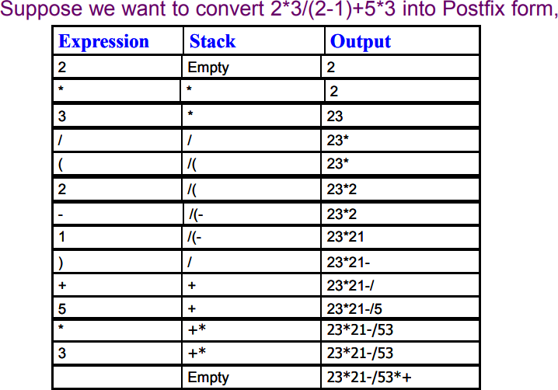
EXAMPLE EXPRESSION

Slide 26
Exercise
Input: A + B * C + D Output: ABC*+D+
Input: ((A + B) – C * (D / E)) + F Output: AB+CDE/*-F+

Slide 27
POSTFIX EVALUATION ALGORITHM
Algorithm postfix (String S) Input:
An expression
Output: Result of an expression
for each character ch in the postfix expression, do
if ch is an operator ⨀ , then
a := pop first element from stack
b := pop second element from the stack res := b ⨀
a
push res into the stack else if ch is an operand, then
add ch into the stack end if return element of stack top
End Procedure

Slide 28
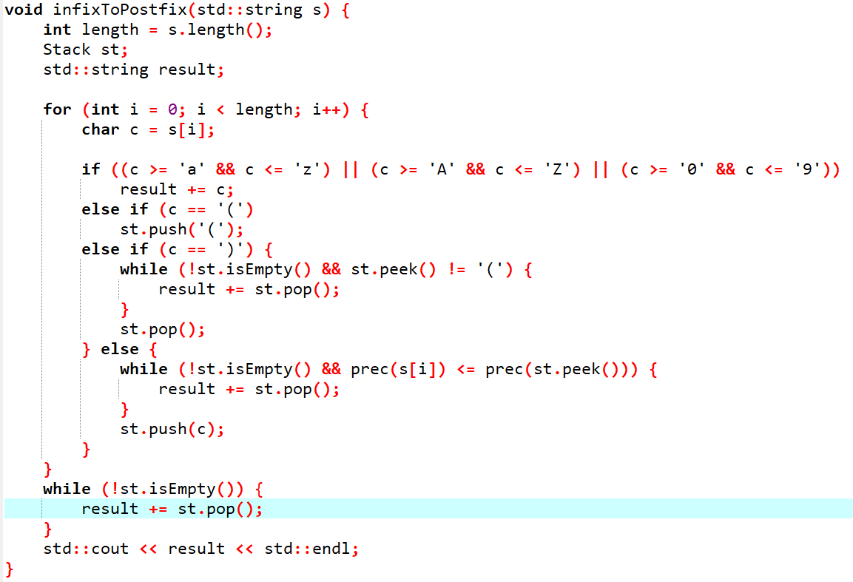
Implementation

Slide 29
TASKS TO BE IMPLEMENTED

Slide 30
INFIX TO PREFIX CONVERSION
Rules for the conversion of infix to prefix expression:
First, reverse the infix expression given in the problem.
Scan the expression from left to right.
Whenever the operands arrive, print them.
If the operator arrives and the stack is found to be empty, then simply push the operator into the stack.
If the incoming operator has higher precedence than the TOP of the stack, push the incoming operator into the stack.
If the incoming operator has the same precedence with a TOP of the stack, push the incoming operator into the stack.
If the incoming operator has lower precedence than the TOP of the stack, pop, and print the top of the stack. Test the incoming operator against the top of the stack again and pop the operator from the stack till it finds the operator of a lower precedence or same precedence.
If the incoming operator has the same precedence with the top of the stack and the incoming operator is ^, then pop the top of the stack till the condition is true. If the condition is not true, push the ^ operator.
When we reach the end of the expression, pop, and print all the operators from the top of the stack.
If the operator is ')', then push it into the stack.
If the operator is '(', then pop all the operators from the stack till it finds ) opening bracket in the stack.
If the top of the stack is ')', push the operator on the stack.
At the end, reverse the output

Slide 31
Example
Input expression | Stack | Prefix expression
Q |  | Q
+ | + | Q
T | + | QT
* | +* | QT
V | +* | QTV
/ | +*/ | QTV
U | +*/ | QTVU
/ | +*// | QTVU
W | +*// | QTVUW
* | +*//* | QTVUW
) | +*//*) | QTVUW
P | +*//*) | QTVUWP
^ | +*//*)^ | QTVUWP
O | +*//*)^ | QTVUWPO
( | +*//* | QTVUWPO^
+ | ++ | QTVUWPO^*//*
N | ++ | QTVUWPO^*//*N
* | ++* | QTVUWPO^*//*N
M | ++* | QTVUWPO^*//*NM
- | ++- | QTVUWPO^*//*NM*
L | ++- | QTVUWPO^*//*NM*L
+ | ++-+ | QTVUWPO^*//*NM*L
K | ++-+ | QTVUWPO^*//*NM*LK
 |  | QTVUWPO^*//*NM*LK+-++

Slide 32
Efficient/Advance sorting techniques
Queue
BST

Slide 33
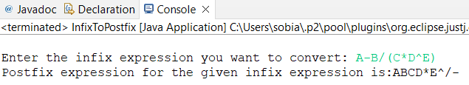
Algorithm:
Public class InfixToPostFix{
Stack operator = new stack();
main(){
String infix;
BufferedReader keyboard = new BufferReader();
Infix = keyboard.readLine();
SOP(toPostFix(infix));} //main end
toPostFix(infix){
Char symbol; , String Postfix= “ ”;
for(i =0; i<infix.length(); i++){
Symbol = infix.charAt(i);
if(Character.isLetter(symbol)){Postfix += symbol;}
elseif(symbol == ‘(‘) {operator.Push(symbol);}
elseif(symbol == ‘)‘) {
while (operators.peek() != '('){ postfix +=operators.pop(); }
operators.pop(); }
else{ while (!operators.isEmpty() && !(operators.peek()=='(') && prec(symbol) <= prec(operators.peek()))
postfix +=operators.pop(); ,operators.push(symbol);
} // else end }// For loop end
while (!operators.isEmpty())
postfix = postfix + operators.pop();
return postfix; }// function end
static int prec(char x) { if (x == '+' || x == '-') return 1;
if (x == '*' || x == '/' || x == '%') return 2; return 0;
}// class end
INFIX | STACK | EXPRESSION
A | EMPTY | A
- | - | A
B | - | AB
/ | -/ | AB
( | -/( | AB
C | -/( | ABC
* | -/(* | ABC
D | -/(* | ABCD
^ | -/(^ | ABCD*
E | -/(^ | ABCD*E
) | -/ | ABCD*E^/-

Slide 34
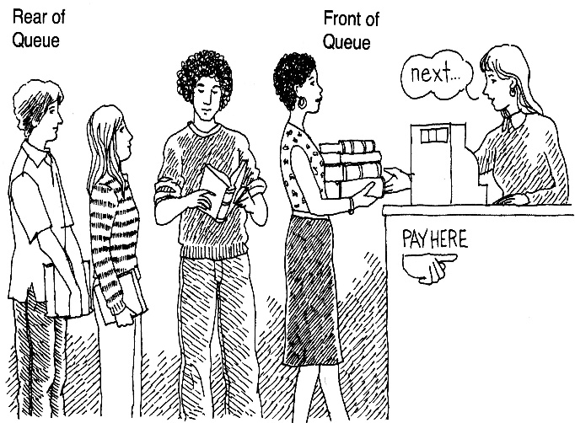

What is a queue?
It is an ordered group of homogeneous items of elements.
Queues have two ends:
Elements are added at one end.
Elements are removed from the other end.
The element added first is also removed first (FIFO: First In, First Out).

Slide 35
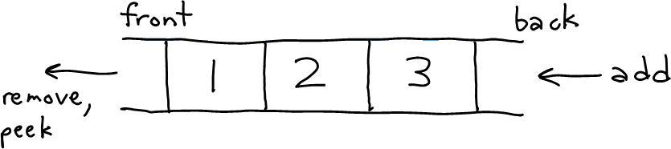
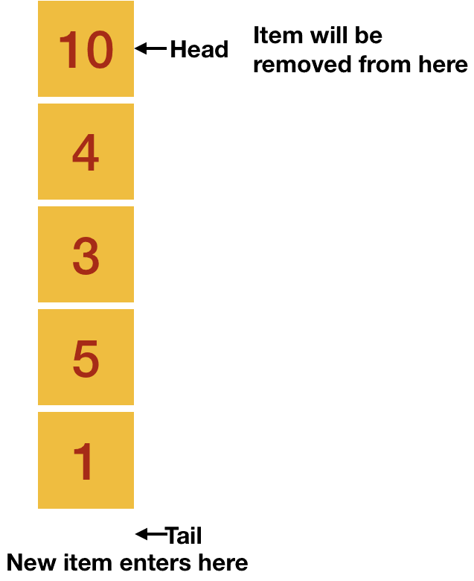
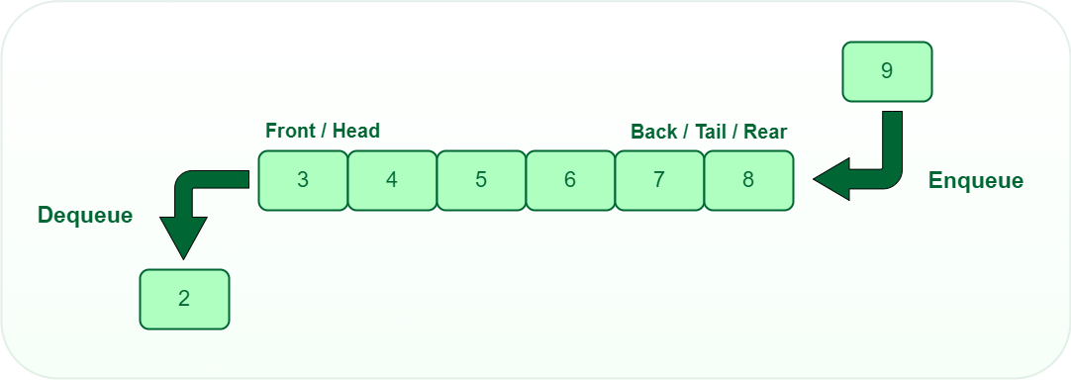
Queue Specification
Similar to a queue of day to day life, in Computer Science also, a new element enters a queue at the last (tail of the queue) and removal of an element occurs from the front (head of the queue).

Slide 36


QUEUE
Similar to the stack, we will implement the queue using a linked list as well as with an array. But let’s first discuss the operations which are done on a queue.
Enqueue → Enqueue is an operation which adds an element to the queue. As stated earlier, any new item enters at the tail of the queue, so Enqueue adds an item to the tail /rare of a queue.
Dequeue → It is similar to the pop operation of stack i.e., it returns and deletes the front element from the queue.

Slide 37
Enqueue (ItemType newItem)
Function: Adds newItem to the rear of the queue.
Preconditions: Queue has been initialized and is not full.
Postconditions: newItem is at rear of queue.
rear: position where elements are added
front: position from which elements are removed

Slide 38
Dequeue (ItemType& item)
Function: Removes front item from queue and returns it in item.
Preconditions: Queue has been initialized and is not empty.
Postconditions: Front element has been removed from queue and item is a copy of removed element.

Slide 39
Types of queue
Linear Queue
Circular Queue
Priority Queue
Deque [ double ended queue

Slide 40
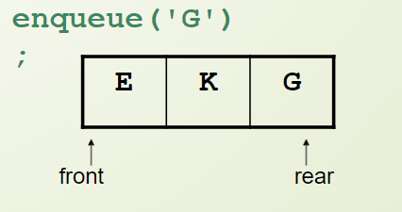
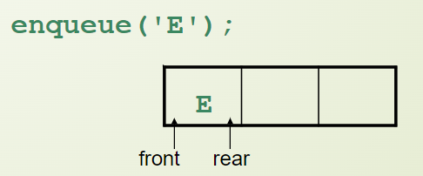
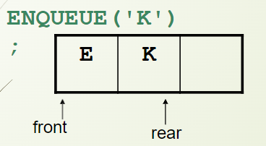
Circular Queue
The circular queue solves the major limitation of the normal queue. In a normal queue, after a bit of insertion and deletion, there will be non-usable empty space.
front, rear
S | K | G
Dequeue // remove E
rare
front
E | K | G
 | K | G
En queue // add s
Queue is full where we have to place “S”
front
front
rear

Slide 41
Applications
Reverse a Word
Palindrome
Language processing
Patients waiting outside the doctor's clinic
A queue of people at ticket-window

Slide 42
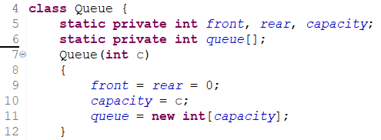
Queue with Array
Steps for enqueue:
Check the queue is full or not
If full, print overflow and exit
If queue is not full, increment tail and add the element
Steps for dequeue:
Check queue is empty or not
if empty, print underflow and exit
if not empty, print element at the head and increment head

Slide 43
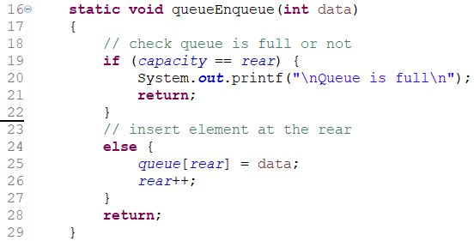
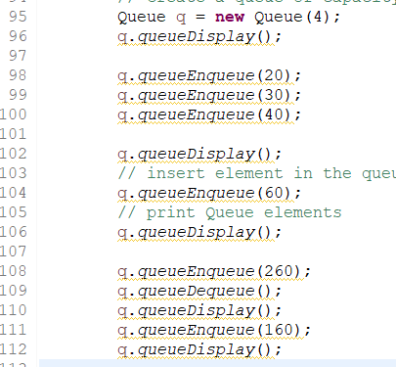
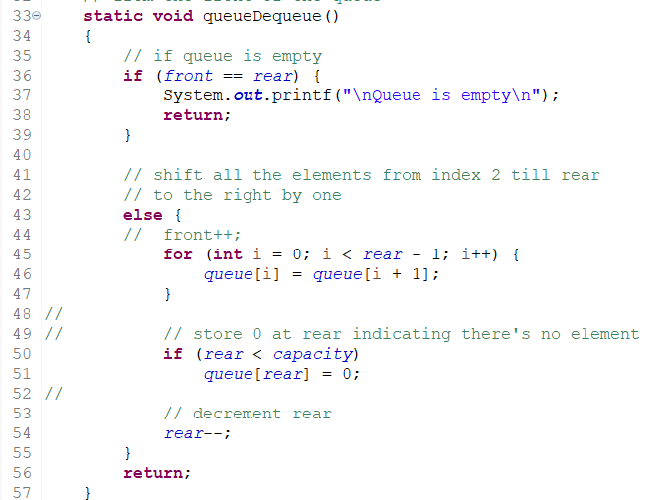
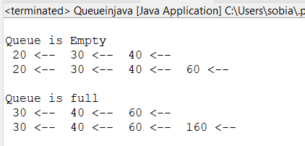
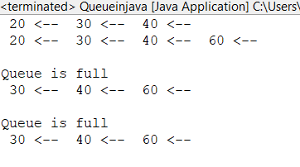

Slide 44
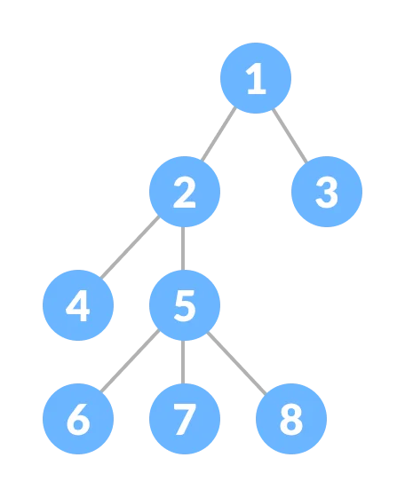
Tree Data Structure
A tree is a nonlinear hierarchical data structure that consists of nodes connected by edges.
Why Tree Data Structure?
Database
Machine Learning /Decision Making
Different tree data structures allow quicker and easier access to the data as it is a non-linear data structure.

Slide 45
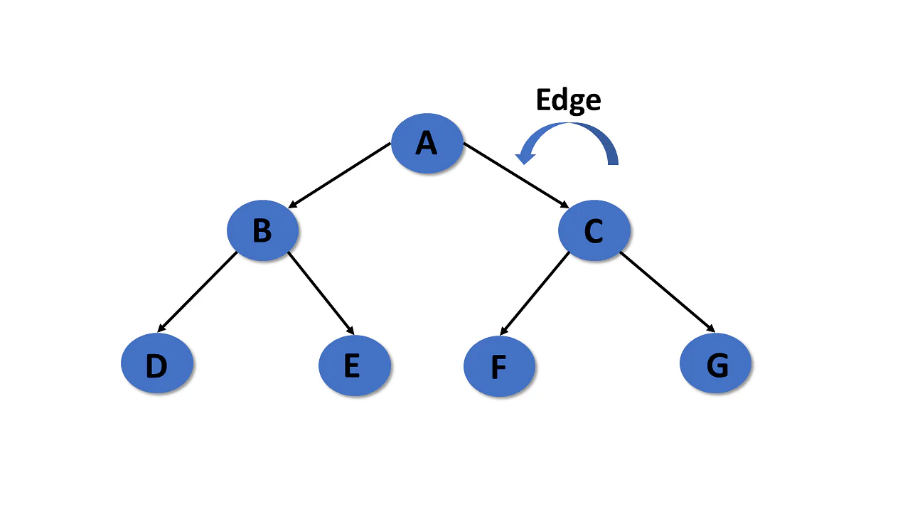
Tree Terminologies
Node:
A node is an entity that contains a key or value and pointers to its child nodes.
Leaf nodes or external nodes that do not contain a link/pointer to child nodes.
The node having at least a child node is called an internal node.
Edge
It is the link between any two nodes.

Slide 46
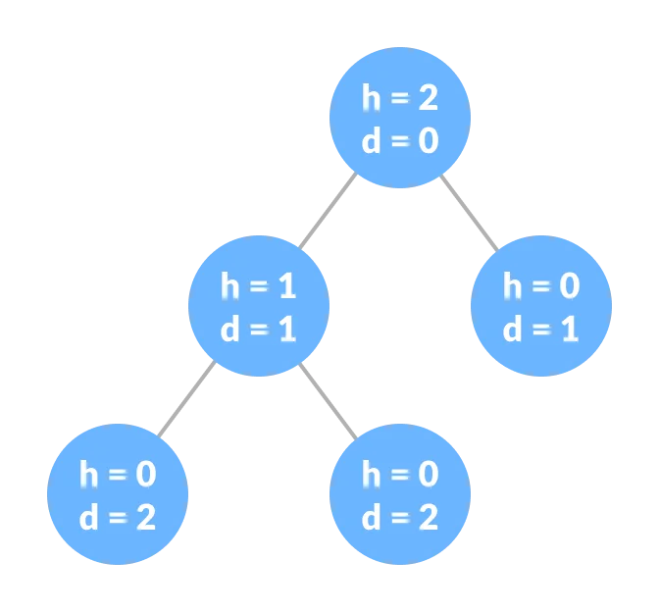
Tree terminology
Height of a Node
The height of a node is the number of edges from the node to the deepest leaf (ie. the longest path from the node to a leaf node).
Depth of a Node
The depth of a node is the number of edges from the root to the node.
Height of a Tree
The height of a Tree is the height of the root node or the depth of the deepest node.
Input: K = 25,
5
/ \
10 15
/ \ / \
20 25 30 35
\
45
Output:
Depth of node 25 = 2
Height of node 25 = 1

Slide 47
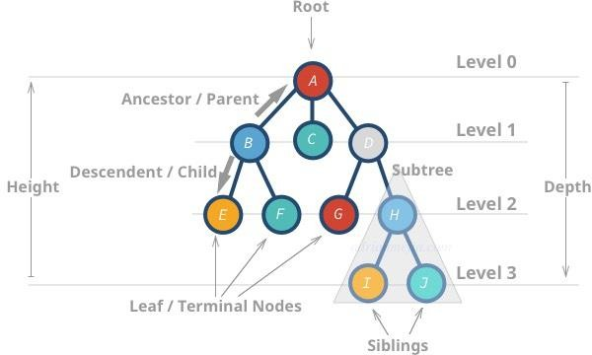
Types of Tree
Binary Tree
Binary Search Tree
AVL Tree

Slide 48
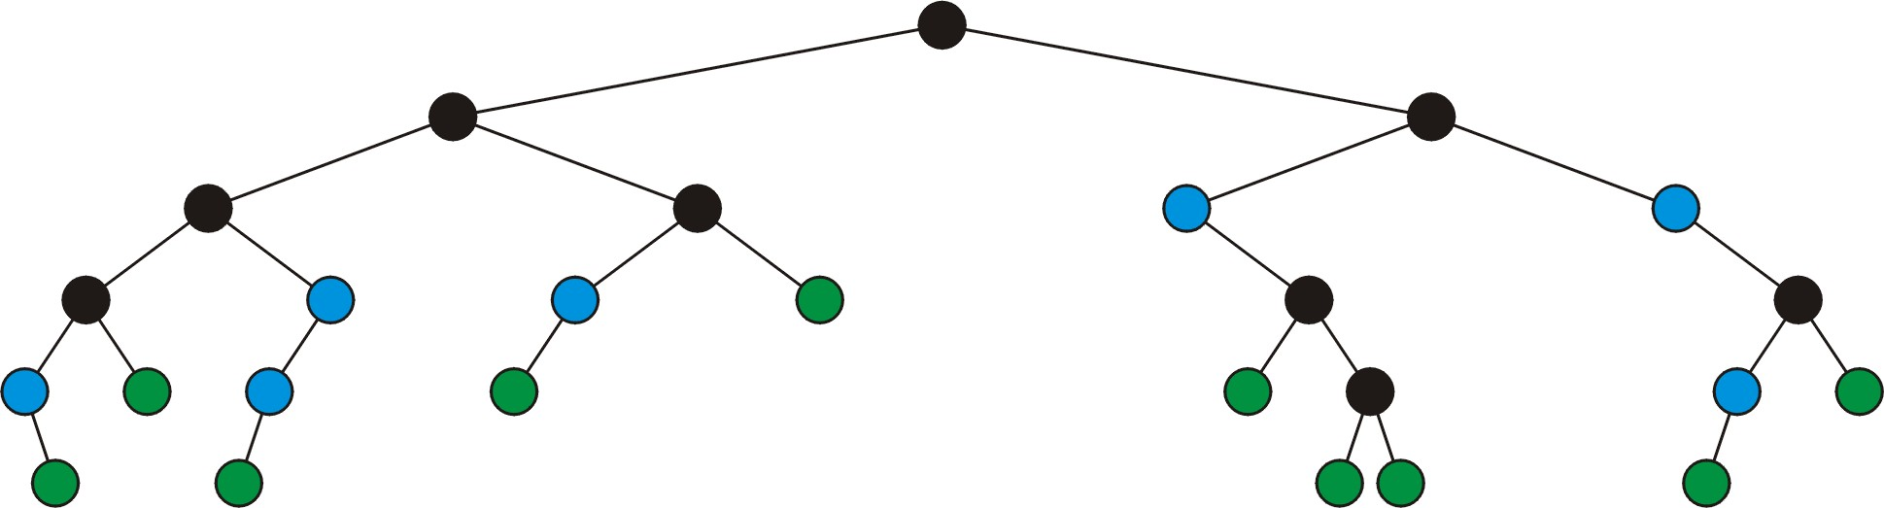



DEFINITION (FULL NODE)
A full node is a node where both the left and right subtrees are non-
empty trees
Legend:
full nodes
neither
leaf nodes

Slide 49
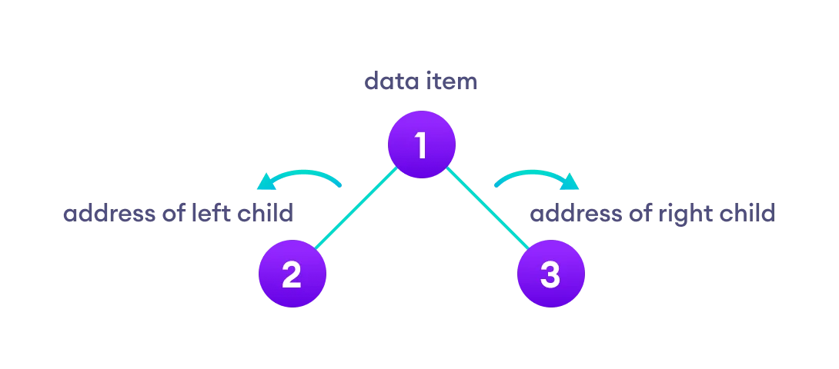
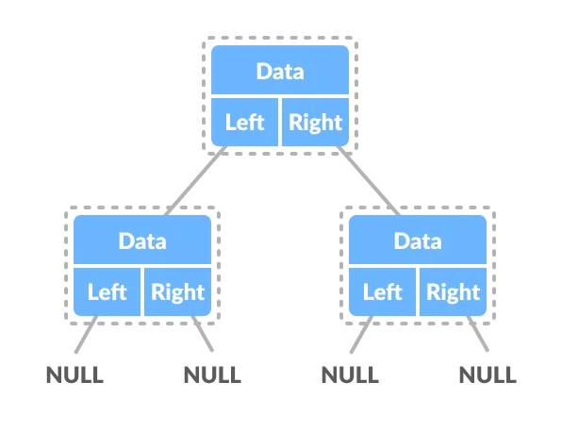
Binary Tree
A binary tree is a tree data structure in which each parent node can have at most two children.
Each node of a binary tree consists of three items:
Max no of nodes possible at any level = 2^i
Max no of nodes at any height h = 2^h+1 -1
Min no of nodes at any height h = h+1

Slide 50
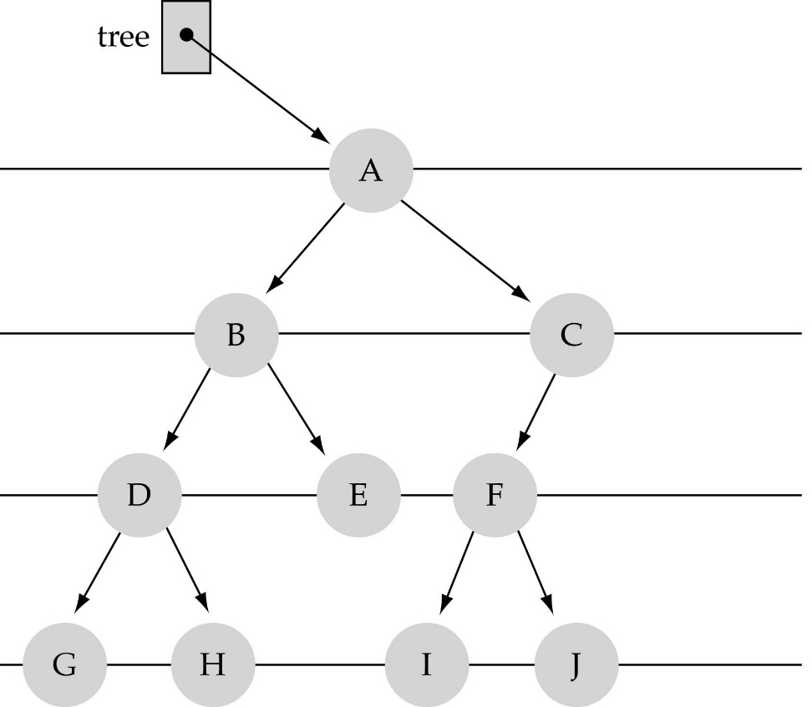
WHAT IS A BINARY TREE?
Property 1: each node can have up to two successor nodes.

Slide 51
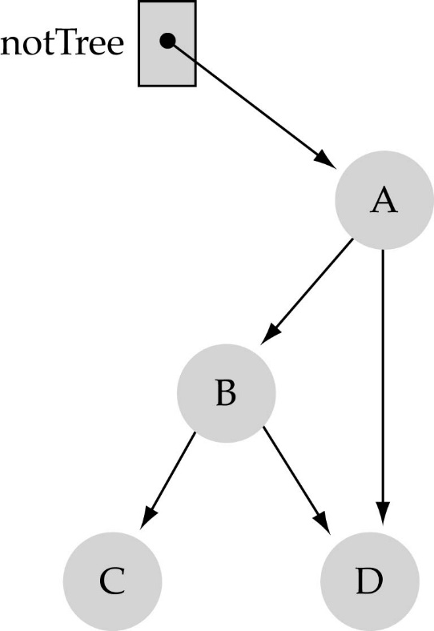
WHAT IS A BINARY TREE? (CONT.)
Property 2: a unique path exists from the root to every other node
Not a valid binary tree!

Slide 52
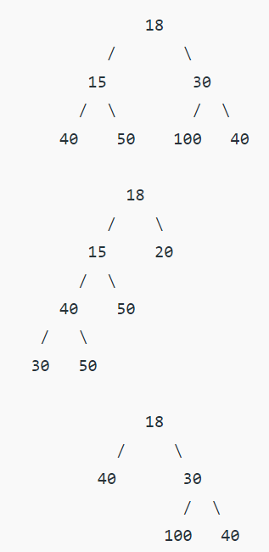

Types of Binary Tree
Full Binary Tree/ strict / proper
A full Binary tree is a special type of binary tree in which every parent node/internal node has either two or no children.
A Binary Tree is a full binary tree if every node has 0 or 2 children. The following are the examples of a full binary tree. We can also say a full binary tree is a binary tree in which all nodes except leaf nodes have two children.
= > no of leaf node = no of internal node +1

Slide 53

2. Perfect Binary Tree
A perfect binary tree is a type of binary tree in which every internal node has exactly two child nodes and all the leaf nodes are at the same level.

Slide 54

Complete Binary Tree
Every level must be completely filled
All the leaf elements must lean towards the left.
The last leaf element might not have a right sibling i.e. a complete binary tree doesn't have to be a full binary tree.

Slide 55



Complete Binary Trees
PERFECT BINARY TREE
:

Slide 56



Binary Tree Implementation

Slide 57


Binary TRAVERSALS:
(a) Inorder (Left, Root, Right) : 4 2 5 1 3 (b) Preorder (Root, Left, Right) : 1 2 4 5 3 (c) Postorder (Left, Right, Root) : 4 5 2 3 1

Slide 58





Slide 59
Implementation of traversal
(a) Inorder (Left, Root, Right) : 4 2 5 1 3 (b) Preorder (Root, Left, Right) : 1 2 4 5 3 (c) Postorder (Left, Right, Root) : 4 5 2 3 1
100
200
100.key
f(100.Lf)
f(100.Rg
400
200.key
f(200.Lf)
f(200.Rg
400.key
f(400.Lf)
f(400.Rg)
0
BaseCase
300
300.key
f(300.Lf)
f(300.Rg)
500
500.key
f(500.Lf)
f(500.Rg
0
public void traversePreOrder(Nod node) {
if (node != null) {
System.out.print(" " + node.key);
traversePreOrder(node.left);
traversePreOrder(node.right);} }
BaseCaase
0
0
BaseCase
BaseCase

Slide 60

Binary Search tree
We will implement a specific type of binary tree: a binary search tree.
• A binary search tree (BST) is a binary tree such that
- all the nodes in the left subtree are less than the root
- all the nodes in the right subtree are greater than the root
- the subtrees are BSTs as well

Slide 61

Example

Slide 62
Operation in BST
Insert
Update
Search
Delete
Traversal
BFT
DFS
In-order, post-order, and pre-order
Finding minimum
Finding maximum
Finding predecessor
Finding Successor
Finding height

Slide 63

FUNCTION INSERTITEM
Use the binary search tree property to insert the new item at the correct place

Slide 64

Insertion Implementation
Algorithm
If node == NULL
return createNode(data)
if (data < node->data)
node->left = insert(node->left, data);
else if (data > node->data)
node->right = insert(node->right, data);
return node;

Slide 65

PREDECESSOR & SUCCESSOR
PREDECESSOR :
A predecessor is a maximum value in a left sub tree
A predecessor of a node is a right most element in a left sub tree.
SUCCESSOR
A successor is a minimum value in a right sub tree
A successor of a node is a left most element in a right sub tree.

Slide 66




FINDING PREDECESSOR & SUCCESSOR

Slide 67

FINDING MAXIMUM
Node max(node head)
{
if(head == NULL)
return NULL;
else if (head->right == NULL) return head;
else
return max(head->right);
}

Slide 68
Deletion

Slide 69

DELETE
A node being erased is not always going to be a leaf node There are three possible scenarios:
The node is a leaf node,
It has exactly one child, or
It has two children (it is a full node)

Slide 70

DELETE
A leaf node simply must be removed and the appropriate
member variable of the parent is set to nullptr
– Consider removing 75

Slide 71

DELETE
The node is deleted and left_tree of 81 is set to
nullptr

Slide 72

DELETE
Erasing the node containing 40 is similar

Slide 73

DELETE
The node is deleted and right_tree of 39 is set to
nullptr

Slide 74

DELETE
If a node has only one child, we can simply promote the
sub-tree associated with the child
– Consider removing 8 which has one left child

Slide 75

DELETE
The node 8 is deleted and the left_tree of 11
is updated to point to 3

Slide 76

DELETE
There is no difference in promoting a single node or a
sub-tree
– To remove 39, it has a single child 11

Slide 77

DELETE
The node containing 39 is deleted and left_node of 42
is updated to point to 11
– Notice that order is still maintained

Slide 78

DELETE
Consider erasing the node containing 99

Slide 79

DELETE
The node is deleted and the left sub-tree is promoted:
The member variable right_tree of 70 is set to point to 92
Again, the order of the tree is maintained

Slide 80

DELETE
Finally, we will consider the problem of erasing a full node, e.g., 42
We will perform two operations:
Replace 42 with the minimum object in the right sub-tree
Erase that object from the right sub-tree

Slide 81

DELETE
In this case, we replace 42 with 47
– We temporarily have two copies of 47 in the tree

Slide 82

DELETE
We now recursively erase 47 from the right sub-tree
– We note that 47 is a leaf node in the right sub-tree

Slide 83

DELETE
Leaf nodes are simply removed and left_tree of 51 is set to nullptr
– Notice that the tree is still sorted:
47 was the least object in the right sub-tree

Slide 84

DELETE
Suppose we want to erase the root 47 again:
We must copy the minimum of the right sub-tree
We could promote the maximum object in the left sub-tree and achieve similar results

Slide 85

DELETE
We copy 51 from the right sub-tree

Slide 86

DELETE
We must proceed by delete 51 from the right sub-tree

Slide 87

DELETE
In this case, the node storing 51 has just a single child

Slide 88

DELETE
We delete the node containing 51 and assign the member variable
left_tree of 70 to point to 59

Slide 89

DELETE
Note that after seven removals, the remaining tree is still correctly
sorted

